Slide 1

Joints

Slide 2
Skeleton – Multiple bones joined by joints
  Synonyms – Arthroses, Articulations
Functions
  Movement
  Transmission of force
  Differential growth

Slide 3
Formation of bone
Mesenchyme
Fibrous tissue
Bone
Mesenchyme
Cartilage
Bone

Slide 4
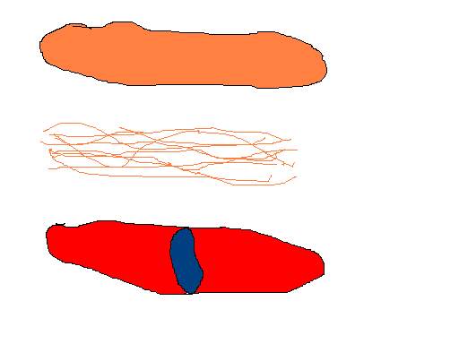
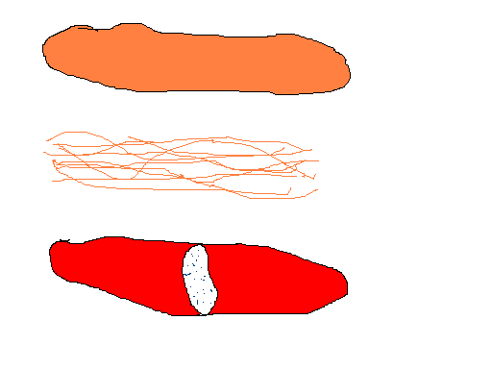
Soft tissue between bones
Solid
Synovial

Slide 5
Fibrous
Cartilaginous
Synovial

Slide 6
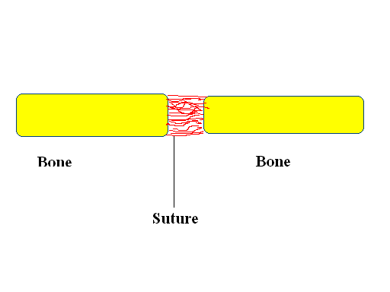
Fibrous joints
Ex:- Skull – Sutures

Slide 7
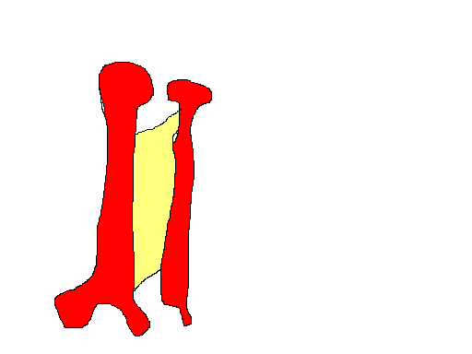
Interosseous membrane

Slide 8
Cartilaginous joints
Primary cartilaginous joints
Secondary cartilaginous joints

Slide 9
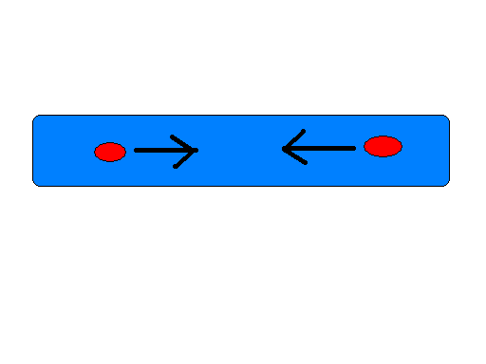
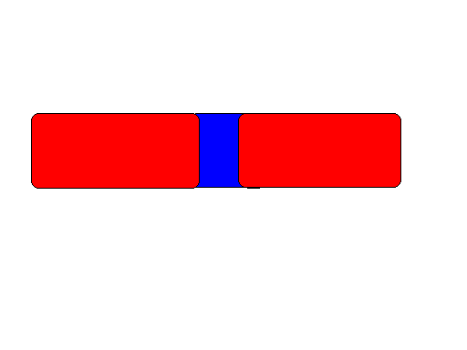
Hyaline cartilage
Ossification centre
Bone
Hyaline cartilage
Primary cartilaginous joint

Slide 10
Examples
Costochondral
First rib – sternum

Slide 11
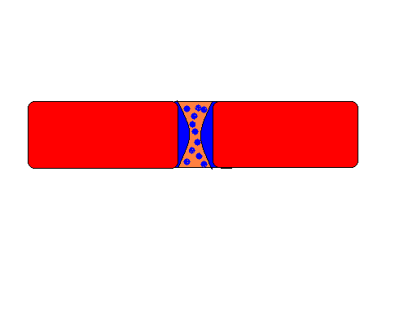
Secondary cartilaginous joint
Bone
Hyaline cartilage
Fibro cartilage

Slide 12
Examples
Midline
  Manubriosternal
  Intervertebral
  Symphysis pubis

Slide 13
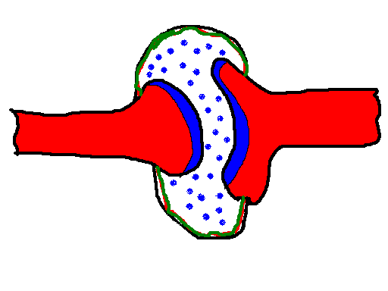
Synovial joints

Slide 14
Synovial fluid
Lubricate
Nutrition to hyaline cartilage

Slide 15
Capsule
Encloses the joint completely
Lined by the synovial membrane

Slide 16
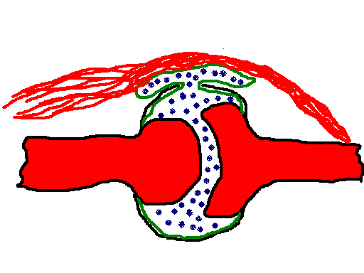
Synovial membrane
Covers intra articular structures completely
When a structure pierces the joint, extends with it for some distance
Sometimes

Slide 17
Structures which are not covered by the synovial membrane
  Discs
  Menisci
  Articular surface

Slide 18
Articular surface
Covered by the hyaline cartilage
Wear resistant – low friction
No nerves or vessels
Nutrition by
  Synovial fluid
  Circulus vasculosus
  Marrow blood vessels

Slide 19
Advancing age – Erosions – called Osteoarthrosis
  ? Due to alteration of synovial fluid viscosity

Slide 20
Capsule
Parallel interlacing collagen fibres
Local thickenings – intrinsic ligaments
Accessory ligaments – separate from the capsule
Expansions from tendons

Slide 21
Abnormal movements prevented by
  Ligaments
  Reflex contraction of antagonist muscles

Slide 22
Synovial membrane
Secretes and absorbs synovial fluid

Slide 23
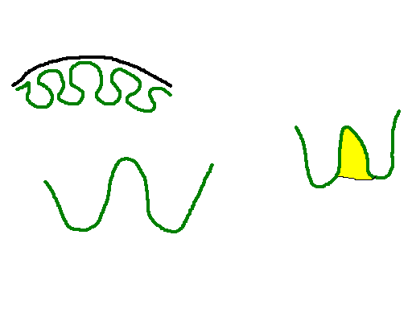
Villi increases with age
Fat pad between folds
Folds

Slide 24
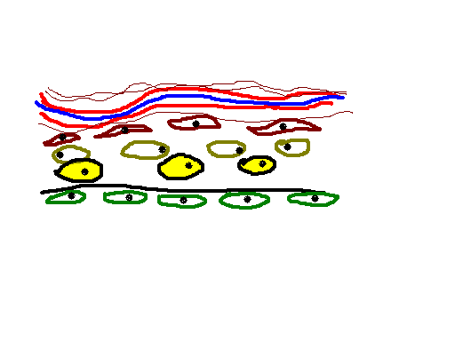
Blood vessels
Fibres
Fibroblasts
Macrophages
Fat cells
Sub intimal lamina
Intima

Slide 25
Functions of intimal cells
Removal of debris
Synthesis
Antigen presentation

Slide 26
Synovial fluid
Found in synovial joints, bursae, Tendon sheaths
Pale yellow, viscous, slightly alkaline at rest
Very low volumes (<0.5cc)

Slide 27
Classification of joints
Depending on
  complexity of form
  Degrees of freedom
  Articular surfaces

Slide 28
Complexity of form
Simple – two surfaces
Compound - > two – Ex. Elbow
Complex – With intra articular structures, Ex. Discs, Menisci

Slide 29
Degrees of freedom
Uni-axial
Bi-axial
Multi-axial

Slide 30
Articular surfaces
Plane – inter metatarsal
Hinge – Humero-ulnar, interphalangeal
Pivot – Atlanto-axial, proximal radio-ulnar
Bicondylar – Knee, TM joint
Ellipsoid – Metacarpo-phalangeal
Saddle – Thumb carpo-metacarpal, Ankle, Calcaneo-cuboid

Slide 31
Ball and socket – Hip and Shoulder

Slide 32
Movements
Gliding – No angulation
Angulation
  Flexion
  Extension
  Abduction
  Adduction

Slide 33
Circumduction
Rotation
Accessory movements

Slide 34
Congruity
Extent to which the bone surfaces are in close contact

Slide 35
Closely packed
Least packed
Maximum congruity
Minimum congruity
Most stable
All ligaments tight
Joint is locked
Least stable

Slide 36
Limitation of movements
Tension of ligaments
Tension of antagonistic muscles
Reflex contraction of antagonistic muscles
Approximation of soft tissue
Limitation of articular surface

Slide 37
Blood supply
Peri articular arterial plexus
  Pierce the capsule and form a sub synovial vascular plexus
Circulus vasculosus – around the articular margin

Slide 38
Lymphatics
Regional nodes

Slide 39
Nerve supply
Moveable joints – nerves supplying their muscles
Region tautened by muscle is supplied by the nerve supplying the antagonists
Synovial membrane – pain insensitive

